Slide 1
TG-119 Quiz
Session 1

Slide 2
Q1
What is the purpose of TG-119?
What type of detectors do they recommend using?
typically would be smaller than a Farmer-type chamber, such as a 0.125 cm3 scanning chamber.
Film
Per field: film, detector array, EPID
How to they take into account daily output changes?
first irradiating the phantom with parallel-opposed 10x10 fields arranged isocentrically and establishing the ratio of reading to planned dose in that geometry.

Slide 3
Q2
Name and describe the two preliminary tests?
AP/PA
10x10, 200 cGy @ iso
Used as ratio for subsequent tests
Bands
5 bands, AP/PA fields, 3 cm wide doses from 40 to 200 cGy

Slide 4
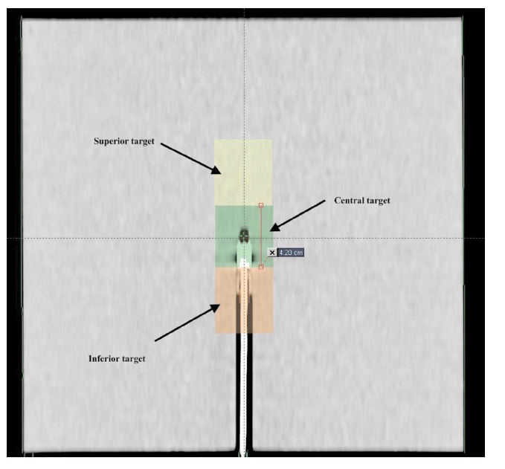
Q3
Explain this test – name, beam arrangement.
Multi-target
7 fields, 50 degrees apart
Explain the dose distribution.
They are to receive different doses, with the central target to receive the largest dose per fraction. The superior targ
What dose criteria are used?
D99, D10to receive 50% of that and the inferior 25%.

Slide 5
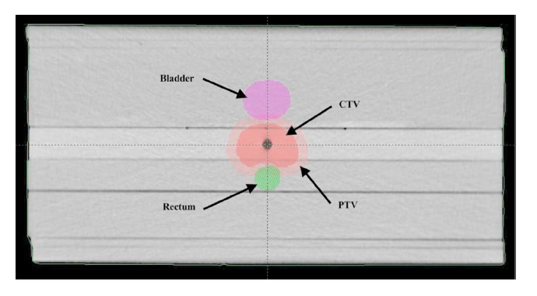
Q4
Explain this test – name, beam arrangement.
Mock prostate
seven fields at 50° intervals
What dose criteria are used?
Prostate – D95, D5
Rectum – D30, D10
Bladder – D30, D10

Slide 6
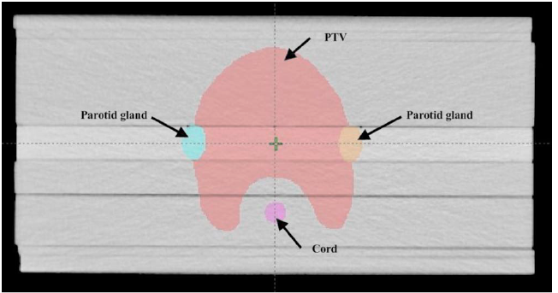
Q5
Explain this test – name, beam arrangement.
Mock head/neck
9 fields at 40° intervals
What dose criteria are used?
PTV D90, D99, D20
Cord Max
Parotid D50

Slide 7
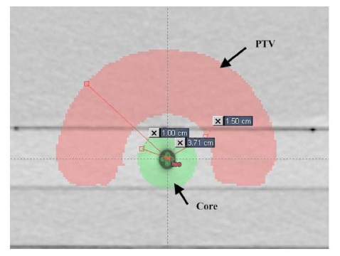
Q6
Explain this test – name, beam arrangement.
C-shape, hard easy
9 fields at 40° intervals
Why are there two versions?
latter goal is probably not achievable and tests a system that is being pushed very hard.
What dose criteria are used?
Easy – central core is to be kept to 50% of the target dose.
Hard - the central core is to be kept to 20% of the target dose.
PTV: D95, D10, Core: D10

Slide 8
Q7 cont.
Explain the confidence limit and how it applies to pass rates?
the sum of the absolute value of the average difference and the standard deviation of the differences multiplied by a factor of 1.96
CL= |mean deviation| + 1.96 SD
It is to be expected that 95% of the measured points will fall within the confidence limit.
average percentage of points passing the criteria was quite high: the overall average was 97.9% with a standard deviation of the average of 2.5%. This corresponds to a confidence limit of 7.0%, which means that the percentage of points passing criteria should exceed 93% approximately 95% of the time.
Should create local confidence limits based on tests, should not exceed TG-119 results
What about VMAT?

Slide 9
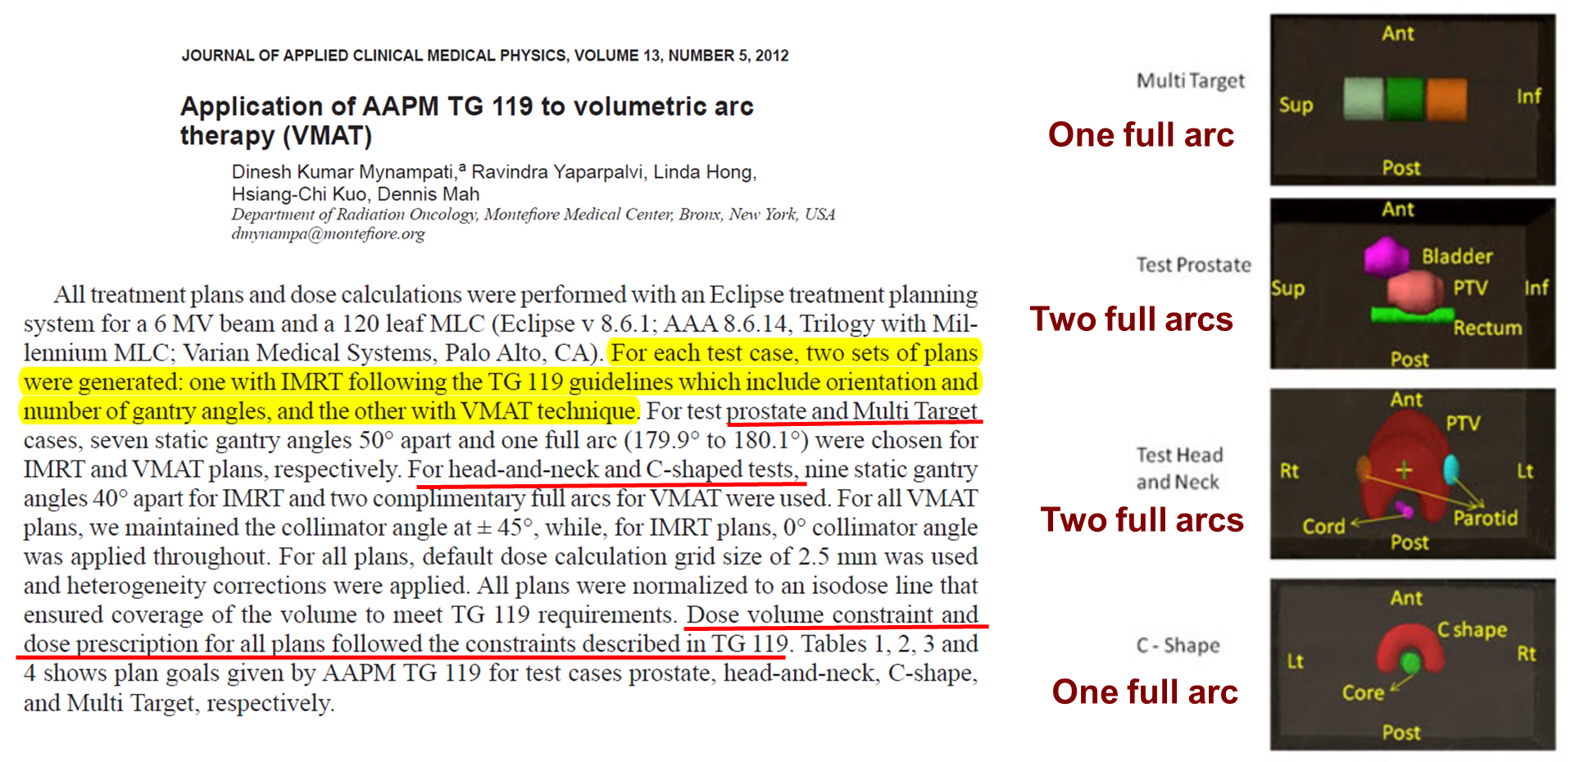
Q7
What about VMAT?

Slide 10
Bonus Question:
Which two Penn Physicists are authors on TG-119?

